Slide 1
DATA ANALYSIS ON CARS24 DATASET
Presented By : Mahajan Neha Ravindra .
Overview : Explore insights from the Cars24 dataset using SQL queries.

Slide 2
Introduction:
The aim of this project is to analyze the cars24 dataset to extract meaningful insights
Dataset & Objectives : The project explores the cars24 dataset to gain valuable insight into cars dataset.
Significance : Insights can inform strategic decision for the automotive industry.

Slide 3
Dataset Overview:
Dataset & Overview : This dataset contains information of cars model, manufacturing years, selling prices, kilometer driven, fuel types, seller types, transmissions, owners, mileage, engine displacement, maximum power, and seats

Slide 4
Methodology:
SQL queries are utilize to analysis the dataset. The queries are including filtering, grouping and ordering to get the meaningful insights.
Queries : To find total mileage, average of selling price, maximum kilometer driven, & by classification etc.

Slide 5
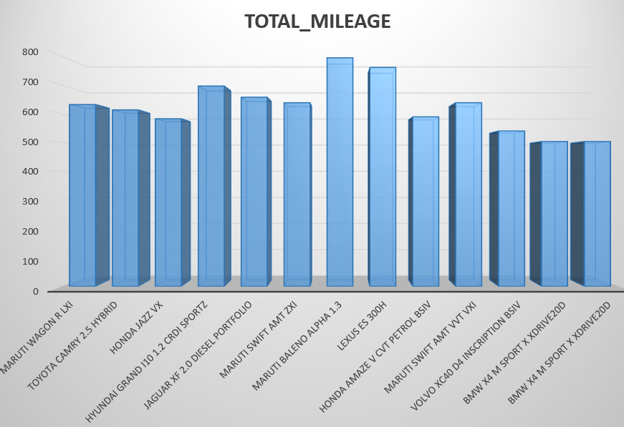
Insights:
Insight 1: Total mileage calculation
Insight 2: Cars with maximum kilometer driven
Total mileage analysis
Yearly distribution
Identify the mileage leader
In depth analysis

Slide 6
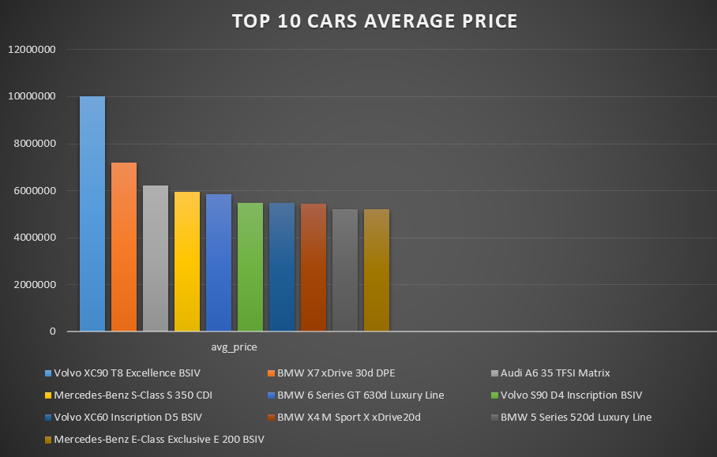
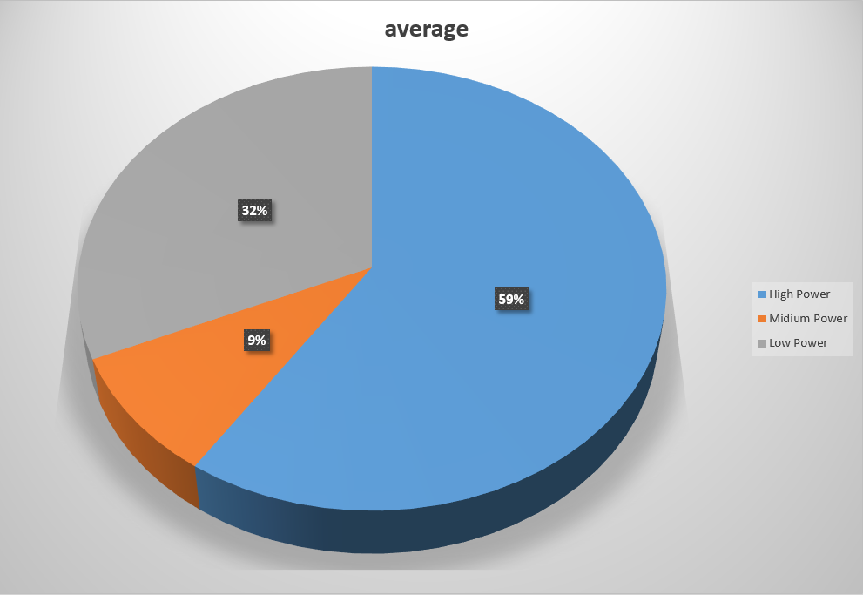
Insight 3: Top 10 cars by average selling price for owners with high mileage cars.
Insight 4: Classifying cars by maximum power & calculating average selling price.
Fuel & mileage filter
Owner specific average
Potential business implications
Power classification
Average selling price
Potential market segmentation

Slide 7
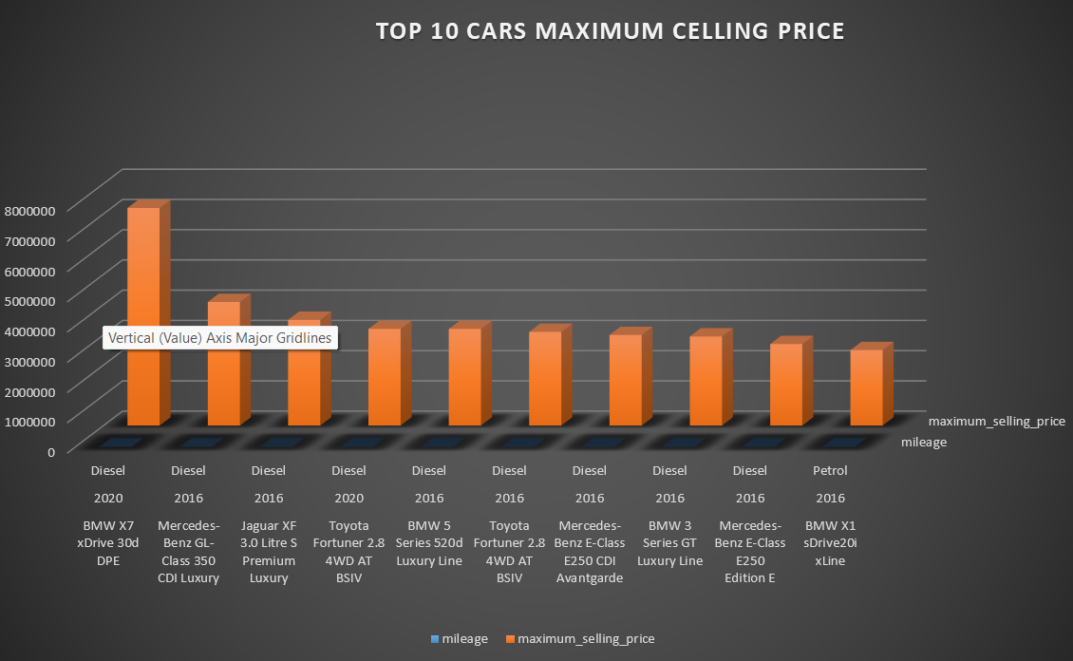
Insight 5: Identifying top 10 cars with maximum selling price for each fuel type in leap years .
Insight 6: Distinct cars with engine displacement above 2000 cc, automatic transmission.
Top selling cars by fuel type
Leap year filter
Market strategy consideration
High performance
Distinct cars details
Market segmentation

Slide 8
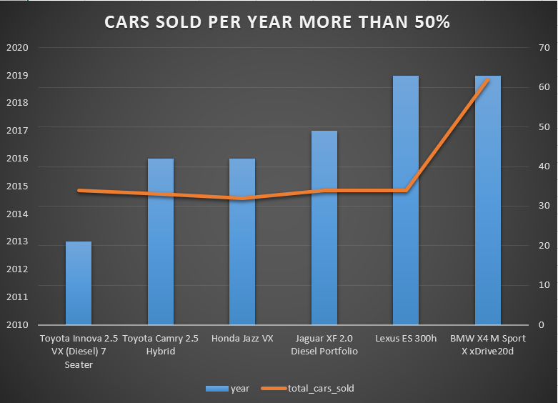
Insight 7: Cars sold per year with more than 50% threshold.
Insight 8: Cars details within price range & seating criteria.
Sales volume overview
Yearly sales trends
Identifying top performance
Potential market leaders
Price range selection
Seating capacity criteria
Consumer decision support

Slide 9
Insight 9: Cars average of kilometer driven & name not starting and ending with vowel.
Insight 10: Owner with maximum cars sold & expensive car details.
Exclusion of vowels in cars name
Calculation of average kilometer driven
Identification of top car seller
Identification of expensive car
Revenue maximization

Slide 10
Conclusion:
The analysis reveals valuable insights about car data, allowing for a better understanding of trends and patterns. Challenges and lessons learned during the analysis contribute to refining future data exploration processes.

Slide 11
Future work:
Potential future work includes more in-depth analysis, predictive modeling, and exploring additional datasets for a comprehensive understanding of the automotive market.

Slide 12
Thank You ! !

